Slide 1
ConfluenceGPT - A Practical Guide To Boosting Your Team's Knowledge Transfer
By Eric Brandt (OSP Dresden)

Slide 2



What To Expect
upload.wikimedia.org/wikipedia/commons/9/93/Amazon_Web_Services_Logo.svg
https://pixabay.com/de/photos/zug-lokomotive-hogwarts-express-8044059/
https://commons.wikimedia.org/wiki/File:Atlassian_Confluence_2017_logo.svg

Slide 3
Agenda
01
02
03
04
Problem Statement
Main Research Questions
Method
Findings

Slide 4
Problem Statement
The main research questions which are critical for context aware systems [1]:
Right Information
At The Right Time
In The Right Place
In The Right Way
To The Right Person
[1]: 10.1145/2254556.2254611

Slide 5
Problem Statement kürzen
Right Information
Right Time
Right Place
Is the content correct?
Is the content up to date?
wasting time to retrieve information
Falling back to colleagues
Getting lost in confluence pages
Similar information from other teams

Slide 6
Problem Statement
Right Way
Right Person
Format (SQL, Code, Docs)
Type of Delivery (Confluence, Toolbox)
I don’t need any information which does not cover my daily business
DEV/BA/PO

Slide 7
Agenda
01
02
03
04
Problem Statement
Main Research Questions
Methodology
Findings

Slide 8

Can We Make Knowledge Transfer With Confluence A More Magical Experience?

Slide 9
If so, how?

Slide 10

Solution Already Available

Slide 11
Agenda
01
02
03
04
Problem Statement
Main Research Questions
Method
Findings

Slide 12
Method
Find out if we can we achieve this on existing providers with minimal effort (AWS)
Try to automate this process
Test the final solution
Check on methods to validate the quality of the output

Slide 13
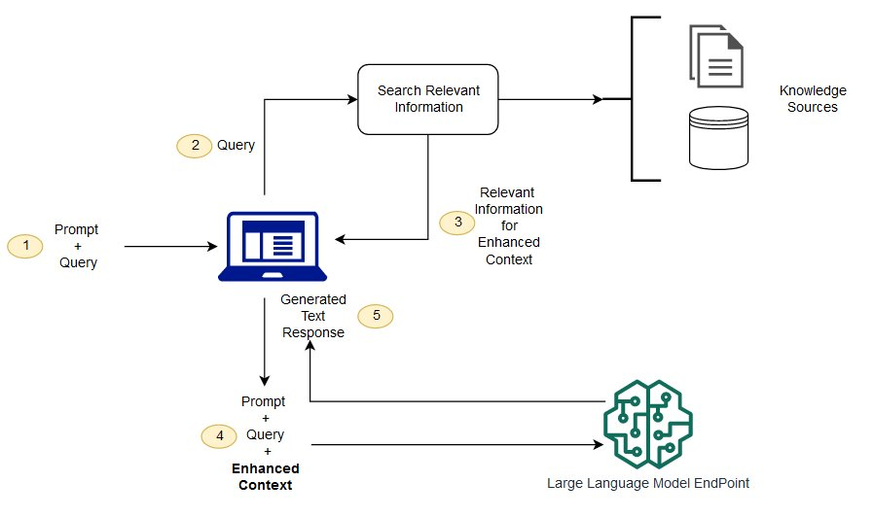
How To RAG On AWS?
Create External Data
Retrieve Relevant Information
Augment LLM Prompt
Update External Data

Slide 14
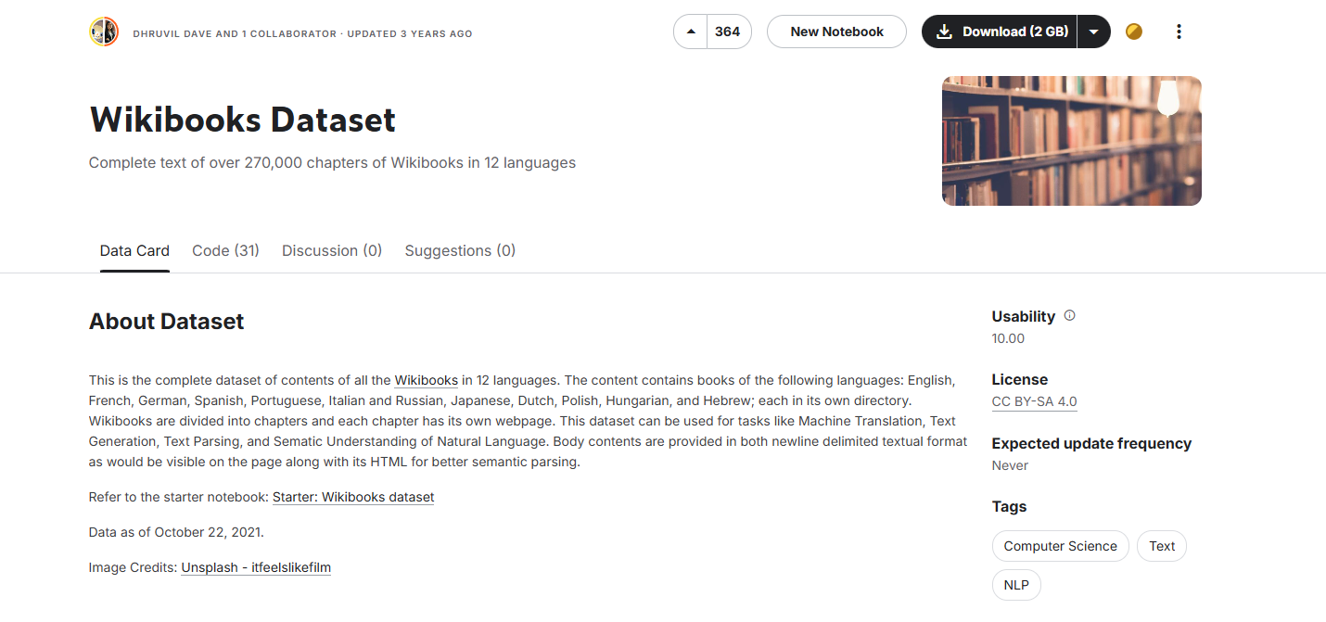
How To Connect Confluence and AWS
REST-API is available
Confluence Integration is available out of the box
Preview – Connect Foundation Models to Your Company Data Sources with Agents for Amazon Bedrock | AWS News Blog
Wikibooks Dataset (kaggle.com)

Slide 15

How To Connect Confluence and AWS
Preview – Connect Foundation Models to Your Company Data Sources with Agents for Amazon Bedrock | AWS News Blog
Wikibooks Dataset (kaggle.com)

Slide 16
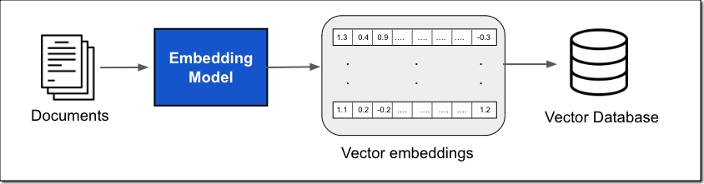
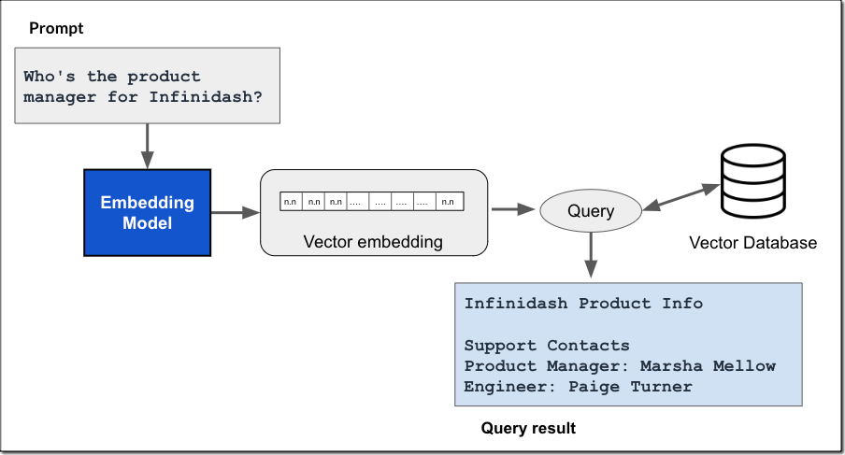
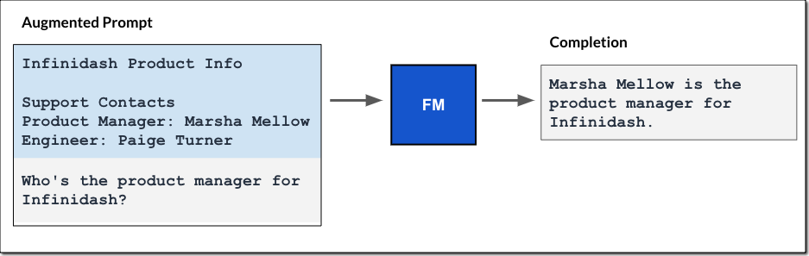
How To Build a Bridge between Confluence and AWS
Core Concepts
Provide Foundational Models with data they didn’t see during training (augmentation)
Preview – Connect Foundation Models to Your Company Data Sources with Agents for Amazon Bedrock | AWS News Blog

Slide 17
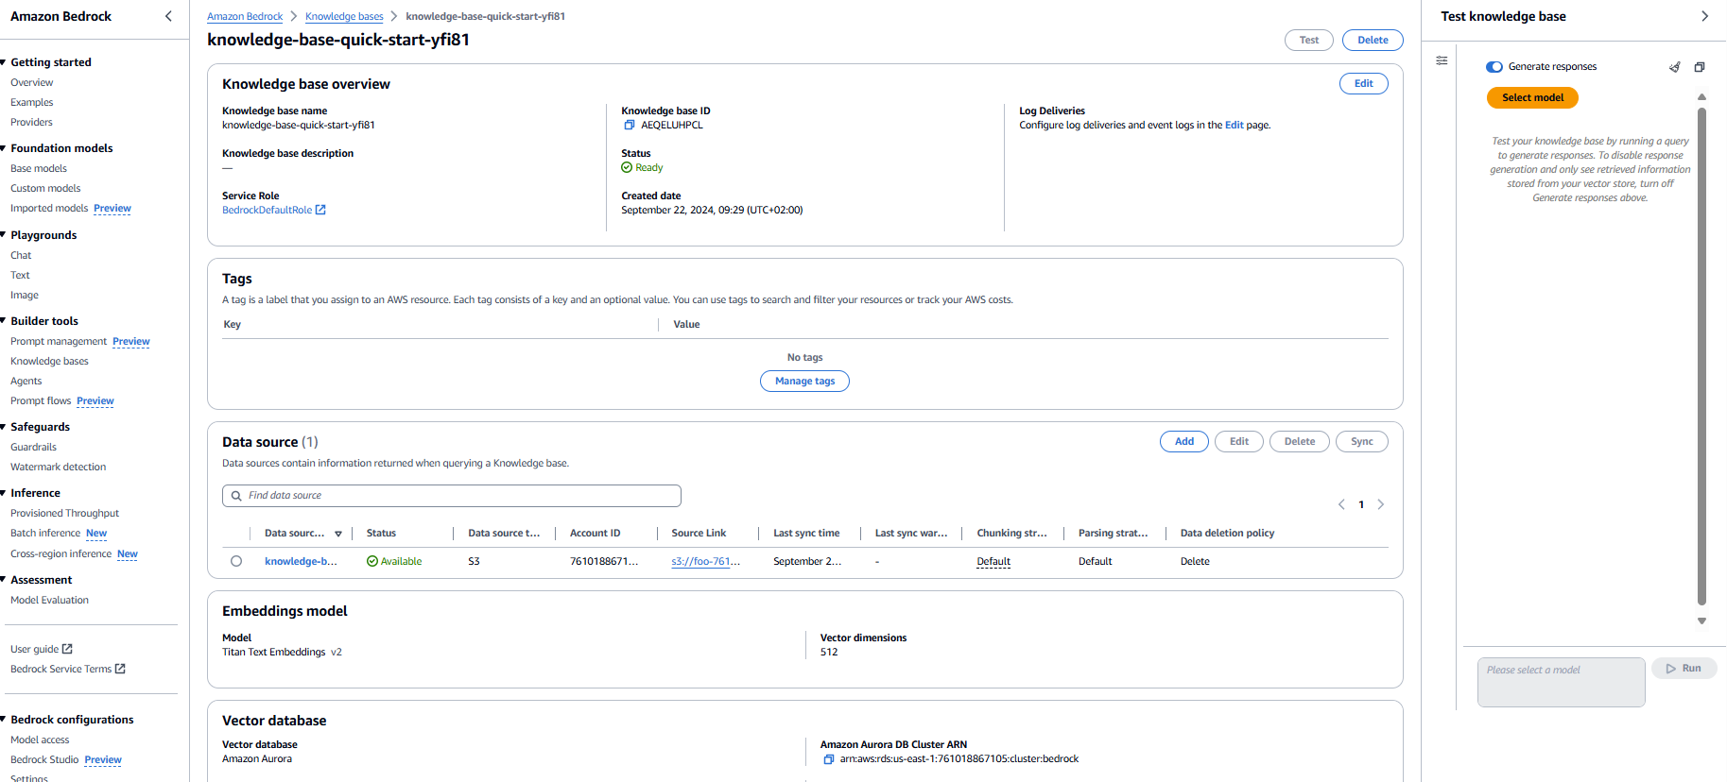
Customized Implementation
4
1
2
3
Preview – Connect Foundation Models to Your Company Data Sources with Agents for Amazon Bedrock | AWS News Blog

Slide 18
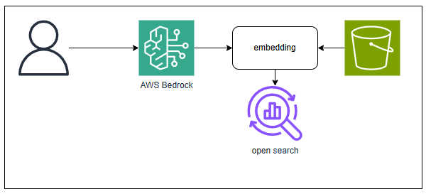
Implementation on AWS Bedrock – Full SaaS
Provide Foundational Models with data they didn’t see during training (augmentation)
Pros:
- Super easy to setup
Cons:
Embedding is a black box and super slow (up to 48 h depending on the size of the file)
Expensive as open search used by default
Preview – Connect Foundation Models to Your Company Data Sources with Agents for Amazon Bedrock | AWS News Blog

Slide 19
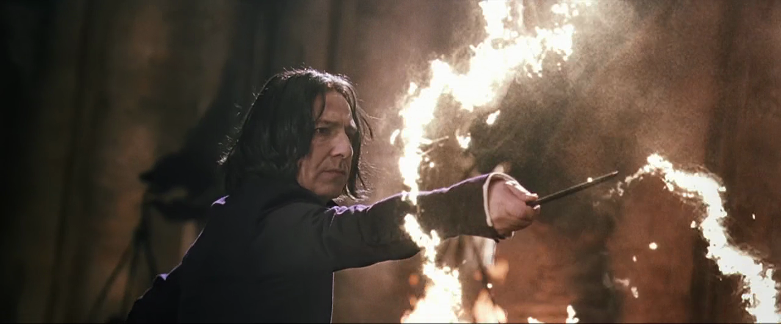
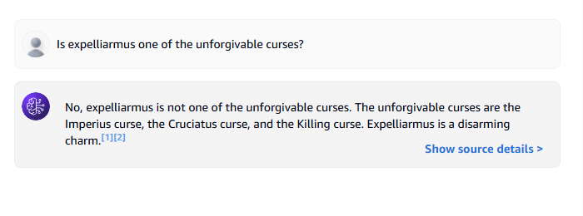
Does it work?

Slide 20

Is It Fast?
embedding takes longer than growing bones back
“For regrowing entire bones, the process was notably slow and painful and could take over a full day”[1]
[1]: https://harrypotter.fandom.com/wiki/Skele-Gro

Slide 21
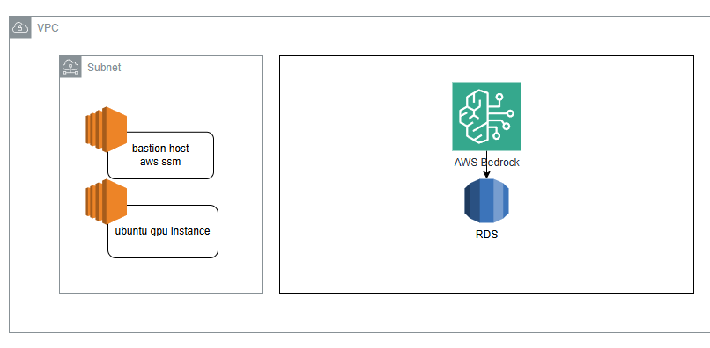
AWS RAG Semi Custom Setup
Replace open search with RDS
Replace bedrock embedding with fastembed

Slide 22
AWS RAG Semi Custom Setup
EAlf91/bedrock (github.com)
module "vpc" {
source = "../modules/vpc"
}
module "rds" {
source = "../modules/rds"
private_subnet_ids = module.vpc.private_subnets_ids
public_subnet_id = module.vpc.public_subnet_id
vpc_id = module.vpc.vpc_id
}
module "bedrock" {
source = "../modules/bedrock"
rds_cluster_arn = module.rds.cluster_arn
rds_password_secret_arn = module.rds.master_user_secret_arn
table_name = "bedrock_integration.bedrock_kb"
dimensions = 1024
}

Slide 23

Goal 1: Reduce Costs

Slide 24
Using RDS instead of OpenSearch
resource "awscc_bedrock_knowledge_base" "bedrock" {
name = "bedrock-knowledge-base"
description = "Bedrock Knowledge base"
role_arn = aws_iam_role.bedrock.arn
storage_configuration = {
type = "RDS"
rds_configuration = {
credentials_secret_arn = var.rds_password_secret_arn
database_name = "postgres"
field_mapping = {
metadata_field = "metadata"
primary_key_field = "id"
text_field = "chunks"
vector_field = "embedding"
}
table_name = var.table_name
resource_arn = var.rds_cluster_arn
}
}
knowledge_base_configuration = {
type = "VECTOR"
vector_knowledge_base_configuration = {
embedding_model_arn = "arn:aws:bedrock:us-east-1::foundation-model/amazon.titan-embed-text-v2:0"
embedding_model_configuration = {
dimensions = var.dimensions
}
}
}
depends_on = [aws_iam_role.bedrock]
}

Slide 25
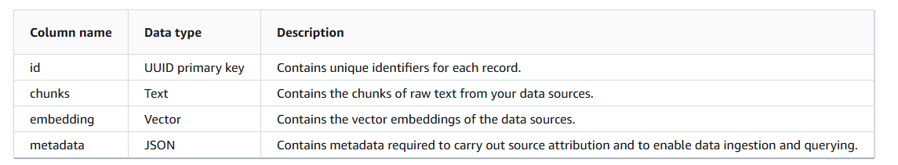
Using RDS instead of OpenSearch
Requires vector extension
Schema, role and permissions must be setup as described in the docs
Using Aurora PostgreSQL as a knowledge base for Amazon Bedrock - Amazon Aurora

Slide 26
Goal 2: Speed Up Embedding Process

Slide 27
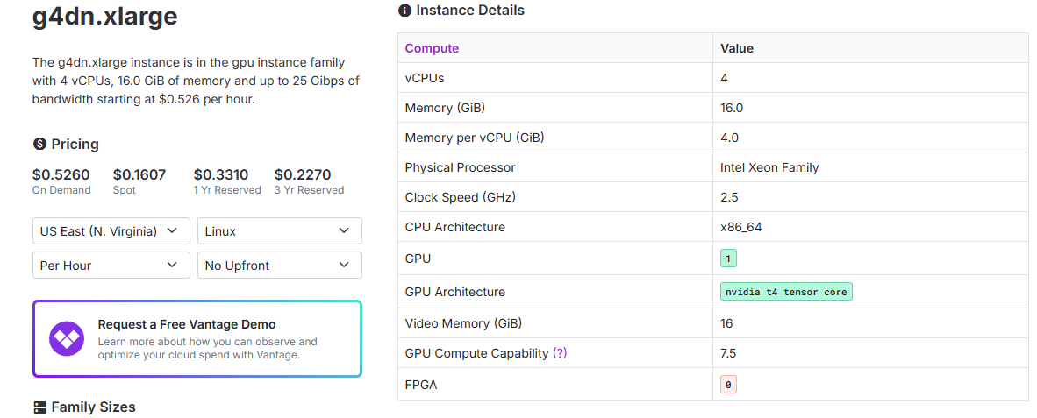

Slide 28
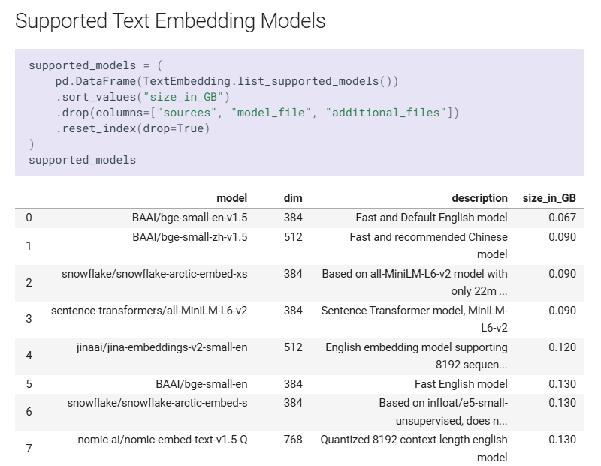
FastEmbed To The Rescue
Supported Models - FastEmbed (qdrant.github.io)

Slide 29
How Does The Data Look Like?
id | embedding | chunks | metadata
ef75bc5a-9487-45d6-9d0e-293d83377995 | [-0.024910122] | e, Harry Potter has "dreams" in which he shares some of Lord Voldemort's thoughts. Voldemort is looking for one Gregorovitch. Harry does not immediately remember this name, though it rings faint bells. It is at the wedding of Bill and Fleur, when a disguised Harry is talking to Viktor Krum, that he remembers that Krum's wand was made by Gregorovitch. Krum says that it was one of the last ones made by him, as he had retired. Harry continues to have dreams about Voldemort's quest for Gregorovitch, including one in which Voldemort questions, and then kills, a woman who dares to say she doesn't know where he went. Finally, Voldemort reaches Gregorovitch, and questions him regarding some item which he supposedly had. Gregorovitch denies having had it, but Voldemort uses Legilimency to read Gregorovitch's memory of a blond thief who had stolen it from his workshop. We do not see the item that had been stolen. Harry, seeing this memory, believes it must be very small. Having retrieved this memory, Voldemort then kil | {"sourceUrl": "s3://bedrock-data-source-761018867105/hp_short_en_2024081321501.md"}
ac29526a-f557-457a-9248-fb6581fe1f2d | [-0.034066305] | ls Gregorovitch. At the end of the book, it is revealed that the object that Gregorovitch had owned and which had been stolen from him was the Elder Wand or the Deathstick, a legendary wand that could not be defeated in a duel. Ollivander tells Harry that Gregorovitch had spread the rumour that he owned this wand and was examining it to determine its secrets, probably in order to enhance his reputation as a wandmaker. The wand was stolen from him by Gellert Grindelwald. Strengths[edit | edit source] Weaknesses[edit | edit source] Relationships with Other Characters[edit | edit source] Analysis[edit | edit source] It is telling that Ollivander so quickly recognizes Gregorovitch's work, and that he is so well acquainted with Gregorovitch's history. Hagrid makes a comment in Harry Potter and the Philosopher's Stone that leads us to believe that Ollivander is not the only wandmaker, but certainly the best, though we don't ever learn whether this means the best in the world, the best in Britain, or the best in Di | {"sourceUrl": "s3://bedrock-data-source-761018867105/hp_short_en_2024081321501.md"}

Slide 30
Agenda
01
02
03
04
Problem Statement
Main Research Questions
Methodology
Findings

Slide 31
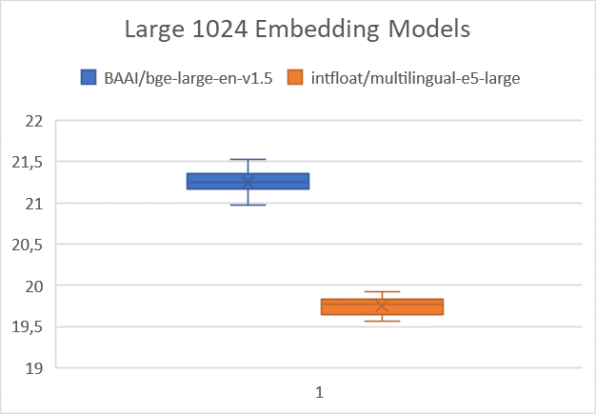
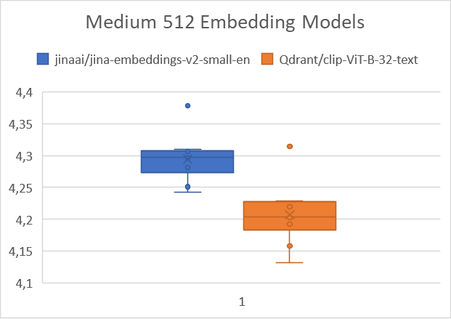
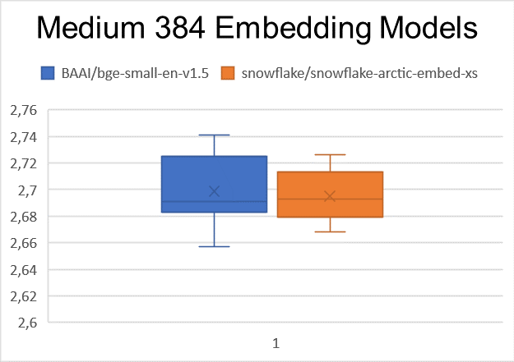
How well does it perform?

Slide 32
Can We Validate This?

Slide 33
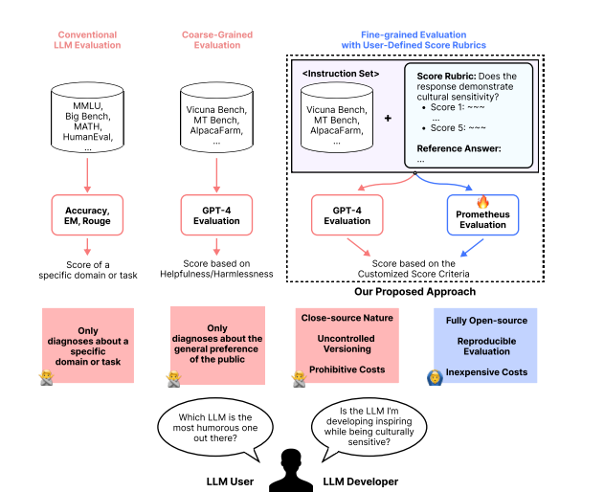
We can!
https://github.com/prometheus-eval/prometheus-eval
https://arxiv.org/pdf/2310.08491

Slide 34
Prometheus Eval Core Components
Instruction
Response To Evaluate
Customized Rubric
Reference Answer
Feedback
Score
https://github.com/prometheus-eval/prometheus-eval
https://arxiv.org/pdf/2310.08491

Slide 35

Any Questions?
https://pixabay.com/de/photos/harry-potter-funco-fantasie-b%C3%BCcher-5055509/

